Slide 1

[ CYBER_SECURITY_Domain ]
AWARENESS
Outsmarting Digital Deception & Securing Human Elements in Cybersecurity
PHISHING

Slide 2
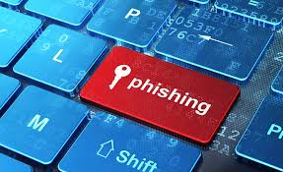
WHAT IS PHISHING?
Phishing is a highly deceptive cyber attack strategy where attackers pretend to be reputable institutions to trick you into revealing sensitive files or user credentials.
Instead of hacking database systems directly, attackers target the human element through psychological triggers.
It remains the primary entry point for over 90% of global organizational cyber incidents.
// Understanding the Threat

Slide 3







THE PHISHING ATTACK CYCLE
1. RESEARCH
2. WEAPONIZE
3. ATTACK
Attackers gather public target info from platforms like LinkedIn or social profiles.
Attackers design identical email templates and fake login clone portals.
Deceptive emails with high-urgency language are bulk-delivered to users.
4. EXPLOIT
Victim submits credentials on the fake link, which immediately leaks to hackers.

Slide 4





SPOTTING EMAIL RED FLAGS
DISPLAY NAME VS DOMAIN
ARTIFICIAL URGENCY
Attackers set name as "PayPal Security" while sending from generic addresses like security@temp-pay-check.com.
High-pressure subject lines bypass rational thinking to trigger rapid, emotional actions before you can verify.
GENERIC GREETINGS
DISGUISED DESTINATIONS
Standard bulk emails use terms like "Dear User" instead of your actual name, signaling mass-delivered campaigns.
Text links might display "microsoft.com", but hovering reveals a malicious destination domain elsewhere.

Slide 5


DETECTING FAKE WEBSITES
LEGITIMATE WEB DOMAINS
TYPOSQUATTED CLONES
Authentic brand pages use precise, simple domains matching their trademark.
Attackers register domain look-alikes that use minor, easily missed characters.
Matches trademark (e.g. github.com)
githunb.com vs github.com
Valid security certificates
github-support.net
No complex nested subdomains
Complex root structures
PRO TIP: Always examine the root domain structure preceding the first slash character in your browser bar.

Slide 6






PSYCHOLOGY OF SOCIAL ENGINEERING
AUTHORITY
FEAR
GREED
Attackers claim to be high-ranking executives or IT directors to exploit hierarchies and compel obedience.
Using potential threats like system lockouts or legal action to induce panic and skip review processes.
Tempting targets with fabricated cash bonuses or gift cards to motivate voluntary entry of login details.

Slide 7


REAL-WORLD ATTACK EXAMPLE
THE MICROSOFT 365 PORTAL SPOOF
An attacker sends a notification claiming you received a confidential shared document. Clicking opens a flawless clone of the M365 credential page.
Outcome: Your password is saved by the attacker, who immediately compromises internal accounts.

Slide 8
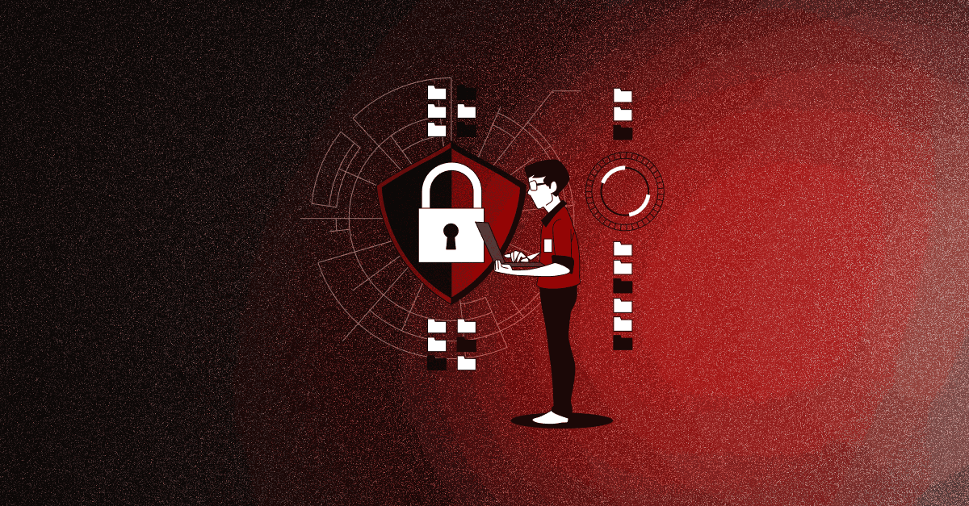
PROACTIVE DEFENSE PRACTICES
Enforce MFA: Implement multi-factor verification. Even with a stolen password, attackers can't gain access.
Hover & Check: Inspect the full destination of any hyperlink before clicking for unexpected domains.
Out-of-Band Verify: Confirm urgent requests from managers using a separate known phone number.
Report Instantly: Use the "Report Phishing" button. Active reporting blacklists servers for everyone.

Slide 9
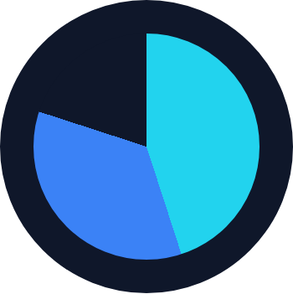
LAYERED DEFENSE MODEL
THE HUMAN SECURITY ELEMENT
Effective security requires a coordinated, multi-layered approach that prioritizes human risk awareness training alongside system defenses.
IMPACT
<5%
Vulnerability Rate
Active MFA (45%)
User Training (35%)
Email Filters (20%)

Slide 10




INTERACTIVE QUIZ: SPOT THE PHISH
[ SCENARIO_B ]
[ SCENARIO_A ]
Student portal announcement points to a document hosted directly under canvas.youruniversity.edu
Email from hr@yourcompany-portal.com reads: "Urgent Update: Verify tax info or face penalty!"
VERDICT: PHISHING!
VERDICT: SAFE!
Domain ends in "-portal.com" and tone leverages panic.
Link leads to official top-level registration domain.

Slide 11
THE EVOLUTION OF THE THREAT
82.6 %
GENERATIVE AI & MODERN ATTACKS
The vast majority of modern phishing attempts are now generated using automated artificial intelligence platforms.
Flawless translation into localized messages.
Traditional defense like "poor spelling" is obsolete.
Automated mass-tailoring of campaigns.

Slide 12
TYPES OF PHISHING ATTACKS
Spear Phishing
Highly targeted attacks aimed at specific individuals using personal details gathered from social media and company websites to appear genuine.
Vishing (Voice)
Attackers call posing as bank officials, IRS agents, or IT support. They create urgency over the phone to extract credentials or wire transfers.
Smishing (SMS)
Fake package delivery alerts, bank fraud warnings, or prize notifications sent via SMS with malicious short links designed to steal personal data.
Whaling
Spear phishing directed at C-suite executives and high-value targets. Often involves fake legal subpoenas or board-level communications.
Clone Phishing
A real previous email is duplicated with malicious links replacing legitimate ones. Victims trust it because they expect the follow-up message.
Pharming
DNS poisoning redirects users from legitimate URLs to fake websites even when typing correct addresses directly into their browser.
No-click required: Some modern attacks compromise systems without any user interaction — keep software and OS always updated.

Slide 13
REAL-WORLD CASE STUDIES
CASE STUDY 1: Twitter Bitcoin Scam (2020)
CASE STUDY 2: Bangladesh Bank Heist (2016)
Attackers phone-spear-phished Twitter employees, gaining admin tool access. 130 high-profile accounts (Obama, Musk, Gates) were hijacked to promote a Bitcoin scam, collecting over $120,000 in under 3 hours. Attack vector: social engineering of internal IT staff, not a system breach.
Hackers sent phishing emails to bank employees, installed malware on internal computers, and issued fraudulent SWIFT transfer orders totaling $1 billion. $81 million was successfully transferred before detection. Entry point: a single employee opening an infected email attachment.
Lesson: Even tech giants fall to human-layer attacks. Train ALL staff levels.
Lesson: One click can cost billions. Email filtering + staff training are non-negotiable.
Global phishing attacks increased 61% year-over-year in 2023 — with financial services and healthcare as the top targets.

Slide 14
ORGANIZATIONAL INCIDENT RESPONSE
What to do when a phishing attack is suspected or confirmed — step by step
01
STOP & DISCONNECT
02
REPORT IT
03
CHANGE CREDENTIALS
04
FORENSIC REVIEW
→
→
→
Do not forward or reply. Isolate affected device immediately from network.
Alert IT/security team immediately. Preserve the email as evidence — do not delete.
Reset all passwords on affected accounts. Enable MFA if not already active.
IT team reviews logs to determine breach scope. Document findings for compliance records.
KEY POLICY: Never penalize employees for reporting suspected attacks. A culture of open reporting reduces organizational risk by up to 70% according to NIST guidelines.
Recommended Tools: Microsoft Defender | Proofpoint | KnowBe4 Training Platform | VirusTotal (link scanner)

Slide 15

QUESTIONS?
Become the Human Shield in Cybersecurity
REPORT SUSPICIOUS ACTIVITY TO:
Fake Amazon: stop-spoofing@amazon.com
Fake Google: reportphishing@google.com
Fake Microsoft: phishing@microsoft.com

Slide 16
Thank You

